Slide 1


Presented By:
Ameya Kulkarni
Prachi Sharma
Prithviraj Naidu
Sarah Fernandes

Slide 2
Introduction
The purpose of the project is to analyze the comparative financial performance of Puma & Adidas and conclude which company has a better market standing.
key ratios have been compared and analyzed for both the companies for the financial year 2016 -2015.
The ratios help us suggest appropriate recommendations to investors and creditors as to which company is better in terms of liquidity and profitability

Slide 3
Background of the organizations
developed the finest iconic footwear, apparel and accessories capable of pushing sport and fashion forward for past 80 years
World extends across Football, Running, Training, Fitness, Golf, Motorsports and design
collaborations with icons such as Rihanna and David Beckham.
impact is instantly felt in the undeniable innovation they have brought to sport, fashion and culture

Slide 4
Timelines Puma
1924: The brothers Rudolf and Adolf Dassler found the company(Dassler Brothers Shoe Factory) in Herzogenaurach, Germany.
1948: Rudolf Dassler founds the PUMA Schuhfabrik Rudolf Dassler. The existing business assets of the “Gebrüder Dassler Schuhfabrik” are divided up between the brothers
2000s:The PPR group, a world leader in apparel and accessories – acquires over 60% of PUMA’s shares. The consolidation strengthens PUMA’s position
2010s: PUMA sponsors seven football federations at the FIFA World Cup 2010 in South Africa. PUMA transforms into a European Corporation and trades under the name of PUMA SE.

Slide 5
Timeline: Adidas
1920s:registered company as "Dassler Brother Shoe Factory” and make their professional start at the Amsterdam Olympic Games. Studs and spikes were introduced for the first time.
1980s:With costs on the rise and Adidas becoming less profitable, Adidas changes from a manufacturing company to a mainly marketing one and becomes a corporation.
2000s:Adidas is also named "Advertiser of the year". Adidas opens the largest sports performance store in the world. Adidas buys out another well-known sports company called Reebok.
2010s:Adidas acquires the outdoor specialist FiveTen, and TaylorMade: first the golf company Ashworth and then, the golf equipment company Adams Golf making the company even stronger

Slide 6
Puma details:
Puma
Parent Company | Puma Societas Europa Incorporation
Category | Apparel and accessories
Sector | Lifestyle and Retail
Tagline/ Slogan | Be Light; Celebrate Anytime Anywhere
USP | Puma products are based on innovation and ultimate comfort in the apparel and shoes
Puma STP
Segment | Sportsmen, Men and women who like sporty energetic apparel with a spray of uniqueness in their apparel.
Target Group | Urban young upper middle class and upper class Men and Women
Positioning | Puma is an international brand with creativity, energy and style in their apparel at a very affordable price.

Slide 7
Adidas details:
Adidas
Parent Company | Adidas Group
Category | Apparel and accessories
Sector | Lifestyle and Retail
Tagline/ Slogan | Impossible is nothing
USP | World famous corporation for sports gear, clothing and other accessories
Adidas STP
Segment | Young men, women and children who have passion for fitness and sports
Target Group | Mostly youth between ages 13-30. The consumer is from upper middle and upper class. The consumer is working and loves sports.
Positioning | Adidas has positioned itself as a leading sportswear brand having stronger connection with sport. The brand has positioned itself as a performance enhancer or booster for the inspiring athletes.

Slide 8
Puma SWOT analysis:
Puma SWOT Analysis
Strengths | 1. Puma is established over 90 countries and employs around 8300 employees all over the world.
 | 2. Puma is the main producer of enthusiast droving shoes and racing suits in both Formula One and NASCAR.
 | 3. It has entered into partnerships with famous companies like Ferrari and BMW.
 | 4. Puma brand is very innovative and has a very rich Research and Development team. The Company produced the first screw boots for football and “Mexico 68” with the innovative brush soles, which were the most comfortable running shoes.
 | 5. It has an excellent brand name throughout the world.
 | 6. The brand has excellent management and marketing strategies and has the advertised the products very well and eye-catching throughout the world.
 | 7. Puma has entered into sponsorships with various players and teams in different sects of the sporting industry.
 | 8. Puma was the official sponsor of the FIFA football World Cup
 | 9. More than 11000+ people are employed with the organization
Weaknesses | 1.Puma has tough competition and limited market share compared to Nike and Adidas
 | 2.High brand switching means difficult to have loyal customer base
Opportunities | 1. The company can attain more sponsorship as more international events in the sporting industry are taking place.
 | 2. Puma can start entering the lifestyle section of the industry
 | 3. More advertising and branding to tap newer customers
 | 4. Puma still has to increase its foothold in the emerging market
Threats | 1. Being a global brand, Puma's business is affected by recession and economic slowdown
 | 2. There is extensive competition from existing players an new players which is growing in the industry.
 | 3. Imitations of Puma brand is extensively increasing causing losses
 | 4. Government policies and regulations can affect business operations

Slide 9
Adidas SWOT analysis:
Adidas SWOT Analysis
Strengths | 2.Diversified portfolio: Company has multiple product portfolios with varied range of footwear & accessories under brand name Adidas (premium segment) & Reebok (mid-range).
 | 3. Strong financial position: With its 2400 store globally accounting $4.3billions.
 | 4.Distribution network: By selling it from online stores to company owned stores to supermarket stores, Adidas has an effective distribution system for their products available through different channels.
 | 5.Branding by creating touch points with the community: Celebrity endorsements & sponsoring major sports organizations such as FIFA, UEFA, NBA & Olympics has increased the awareness of Adidas in the market & hence it has increased the highly targeted customer base as well.
 | 6.Collaborations & memberships: Strong relationship within the sustainability area with organizations such as International Labor organization, International Finance Corporation has given the company an edge over competitors so that they can have a sustainable business.
Weaknesses | 1.Premium price range: High price range due to innovative technology & Production methods have made the brand affordable to limited customers only, especially in developing countries.
 | 2.Outsourced manufacturing: Adidas has 93% of production outsourced to 3rd party manufacturers (largely to Asia) to avail of low labor cost & easy availability of resources. They are running a risk of over dependency on outsourcing especially in Asian markets. Also, the overall quality of products perceived by the consumers of developed economies is a major concern as far as brand is concerned.
 | 3.Limited product line: Adidas along with the recently acquired Reebok brands, has got only 2 brands under their group although they have got deep assortments within these brands. Thus, there is more scope for product line expansion.
Opportunities | 1.Changing Lifestyle: With the saturation of developed economies, changing taste & preferences, education & changing lifestyle of developing economies, there is a steep rise in the demand of premium goods & services.
 | 2.Market development: Entering into new markets will be the only way to succeed in the future because developed economies are already having high competition.
 | 3.Expansion in product line: Expanding its product line will open a new set of opportunities while at the same time it can differentiate itself from the competitors by following this strategy.
 | 4.Increasing demand of premium products: If we only consider the Indian market then there is a growth rate of 33% in demand of premium products. This tells us the future business opportunity & expanding market size of developing economies.
 | 5.Backward integration: This will be smart strategy if followed by Adidas as it will help Adidas to secure their patent rights & also integrate their R&D with the operational team to work in open system.
Threats | 1.Competition: Although Adidas is a global brand but it is facing fierce competition from other brands like Nike which is No.1 brand and Adidas being in 2nd Position in this premium segment. Besides this, there is regular competition from local players, substitutes and market penetrators.
 | 2.Supplier Dominancy: Due to majority of its production being outsourced; Suppliers have more bargaining power then the company.
 | 3.Government Regulations: With its 35% products manufactured in China & 93% of production happening in Asia, Import regulations, duty & tariffs plays a critical role in the pricing and success of the company.

Slide 10
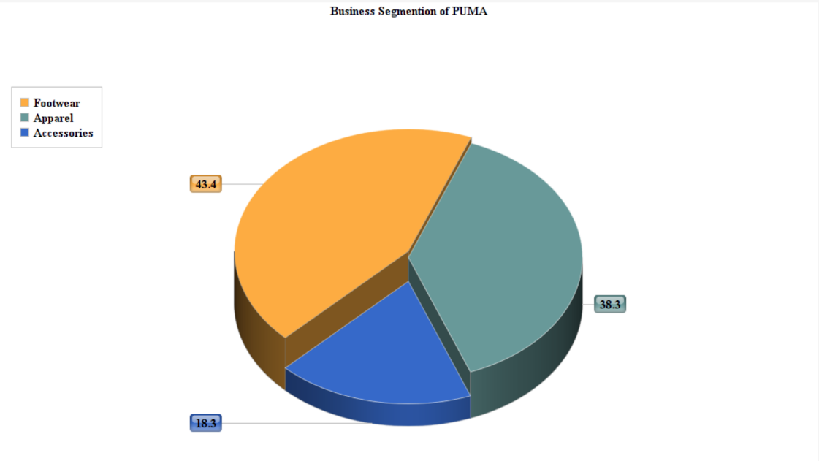
Business segmentation: Puma
Targeting strategy is the cornerstone of the product development process
Puma uses differentiated targeting strategy for assorted products categories.
Footwear range: Cross training, motor sports, soccer, tennis and other activities.
Apparel line: T-shirts, track jackets, pants and sweatshirts.
Accessories: Backpacks, belts, headwear, socks and utility bags.

Slide 11
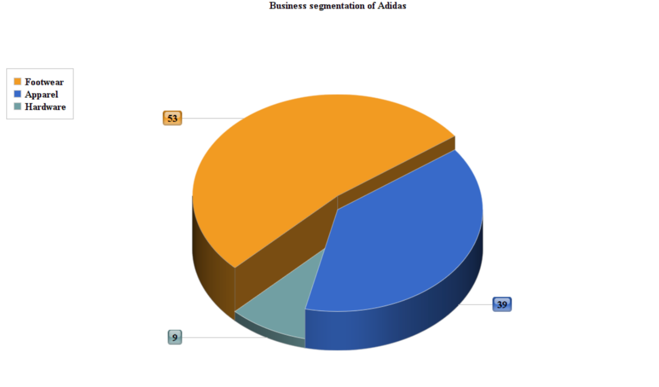
Business segmentation: Adidas
Adidas uses differentiated targeting strategy for assorted products categories.
Targeting strategy is the cornerstone of the product development process.
Hardware/Accessories: Golf products, Utility bags, Training equipment, Football equipment.
Apparel line: T-shirts, hoodies, Sweatshirts, tights, sports pants.
Footwear: Running shoe, cross training shoes, golf shoes, basketball and Football shoes.

Slide 12

Risks Management by Adidas & Puma:
Risks | Adidas Strategy | Puma Strategy
Macroeconomic Developments | Reallocation of investments An increased focus on cost control | Geographic diversification Development of alternative scenarios
Legal Risks | ADIDAS closely monitors changes in legislation | Continuous monitoring of contractual obligations Integration of internal and external legal experts
Liquidity Risk | An efficient cash management system to manage liquidity risk Cash and cash equivalents together with marketable securities amounted to 1.515 billion euros. | A central financing approach like rolling cashflow planning Internal financing
Personnel Department | Invests in improving employer branding activities | A control process place to detect and assess human resource risks Attention to managing talent & identifying key positions

Slide 13
Summary of most recent earnings call
Puma | Adidas
1) Sales increase by 14.5% currency adjusted to € 1,040 million (+8.6% reported) | 1) sales for the company were up 9% in the third quarter to € 5.677 billion as compared to € 5.222 billion in 2016
2) Gross profit margin improves by 250 basis points to 47.1% | 2) Gross margin improves 2.4pp to 50.4%
3) Operating expenses (OPEX) increase by 11.7%. | 3) Operating expenses increased 8% to € 2.129 billion
4) Net earnings more than double from € 62 million to € 136 million. | 4)Net income from continuing operations grows 35% to € 549 million
5) EPS increase from € 4.17 to € 9.09 | 5) EPS from continuing operations increases 33% to € 2.70

Slide 14
Compensation Policy: Puma
The compensation of the Managing Directors consists of nonperformance-based and performance-based components.
The criteria for calculating the total remuneration are the economic situation, long-term strategic planning and related targets, the long-term durability of targeted results and the Company's long-term prospects
The bonus component of performance-related compensation is mainly based on the PUMA Group’s operating income (EBIT) and is staggered according to the degree to which targets are met. In addition, qualitative individual goals are set
Under the new performance-based program, 70% of the compensation will be based on the medium-term performance of PUMA SE’s share and 30% will be based on the medium-term performance of Kering SA’s share in relation to benchmark companies.

Slide 15
Compensation policy: Adidas
In case of 100% target achievement, the total compensation (without other benefits and pension payments) is made up of around one-third fixed compensation and around two-thirds performance related compensation components.
At its equitable discretion, the Supervisory Board may grant a special bonus in case of extraordinary performance by an Executive Board member which is not related to performance criteria
Such special bonus is limited to a maximum of 100% of the annual fixed salary of the calendar year for which the special bonus is granted.

Slide 16
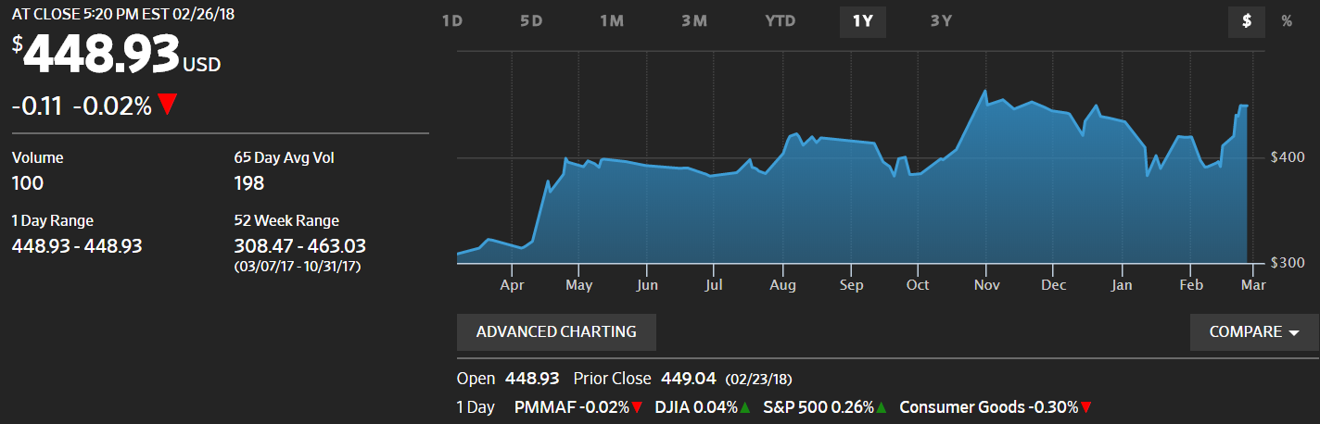
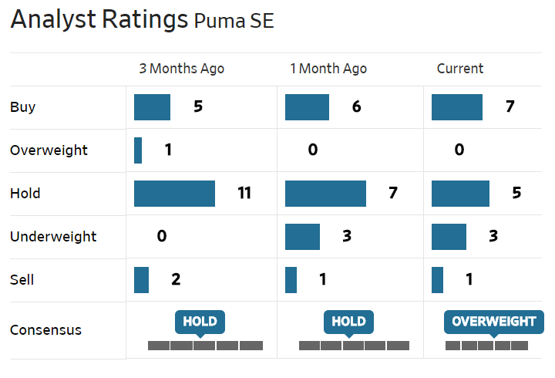
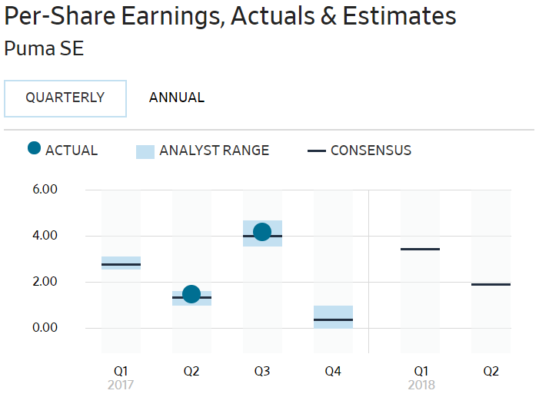
PUMA Current Market Position
As of 6th March 2018, the current market standing of PUMA is at $448.93 (as per Wall Street Index)
Currently, PUMA’s stocks are in Overweight position which makes their stocks preferable to buy.

Slide 17
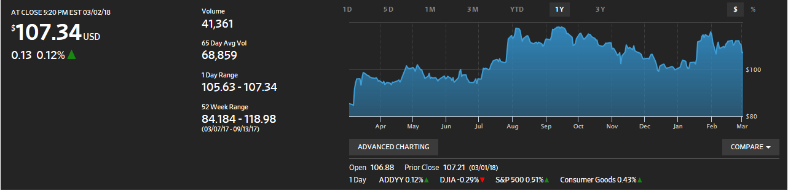
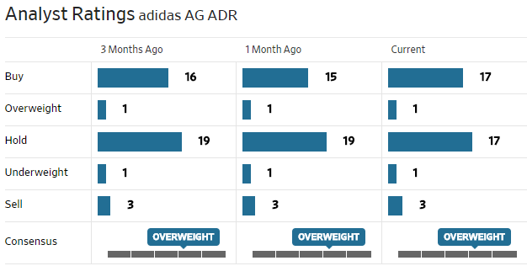
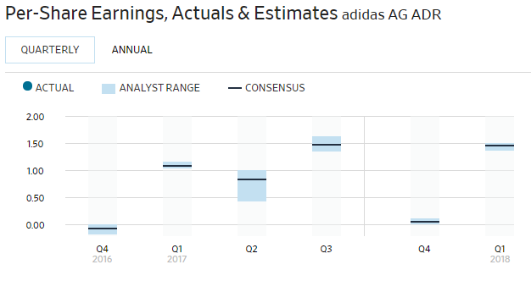
ADIDAS Current Market Position
As of 6th March 2018, the current market standing of ADIDAS is at $107.34 (as per Wall Street Index)
Currently, ADIDAS’s stocks are in Overweight position which makes their stocks preferable to buy.

Slide 18
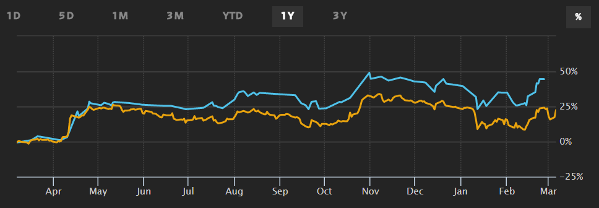
Comparative Analysis between Market Position
Puma- Adidas-
Adidas’s stock is consistently overweight.
Adidas’s stocks are in the better position today.
the valuation equation still favors Adidas.

Slide 19
Financial Performance
Measuring financial performance is based on a given period and similar firms across the same industry or used to compare industries or sectors in aggregation.
the act of performing financial activities and indicates whether financial objectives are being accomplished.
is required to maintain organization’s liquidity in day-to-day operation to ensure its smooth running and to meet its obligation.
Decisions which are based on finance performance analysis help the maximization of shareholders or owner’s wealth.
Adidas group and Puma group financial reports ending December 2016 have been Analyzed.
Analysis is based on balance sheet and the income statement

Slide 20
Horizontal Analysis
The horizontal analysis is useful to see the impact of operational results on a company‘s financial condition over the review period.
Its is used to identify the changes in the amounts of corresponding financial statement items over a period
The analysis is based on two periods of accounts and earliest period is used as the base period after which all later periods are compared.
The based period amount is calculated as 100% and each following period is expressed as a percentage of the amount in the base year.
Its useful to see the impact of operational results on a company's financial condition over the review period.

Slide 21
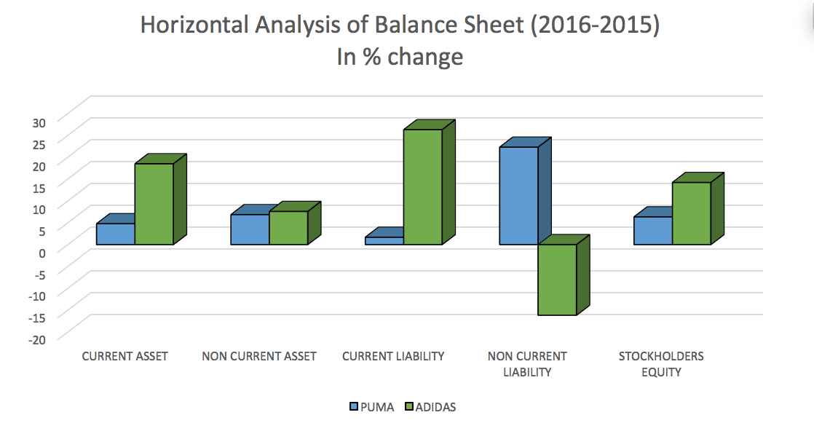
Horizontal Analysis of Balance sheet
Horizontal analysis done for balance sheet of financial year 2015 and 2016 gave us an insight about changes in Assets and liability standing of the companies
For Adidas, % change for Non-Current liability is negative, it had higher Non-current liability last year in comparison to the Current year which shows that it can pay off most of its Non-Current liabilities
Adidas has also significant % increase in Current asset and Stockholder equity but has incurred a greater % increase in its liabilities as compared to Puma.

Slide 22
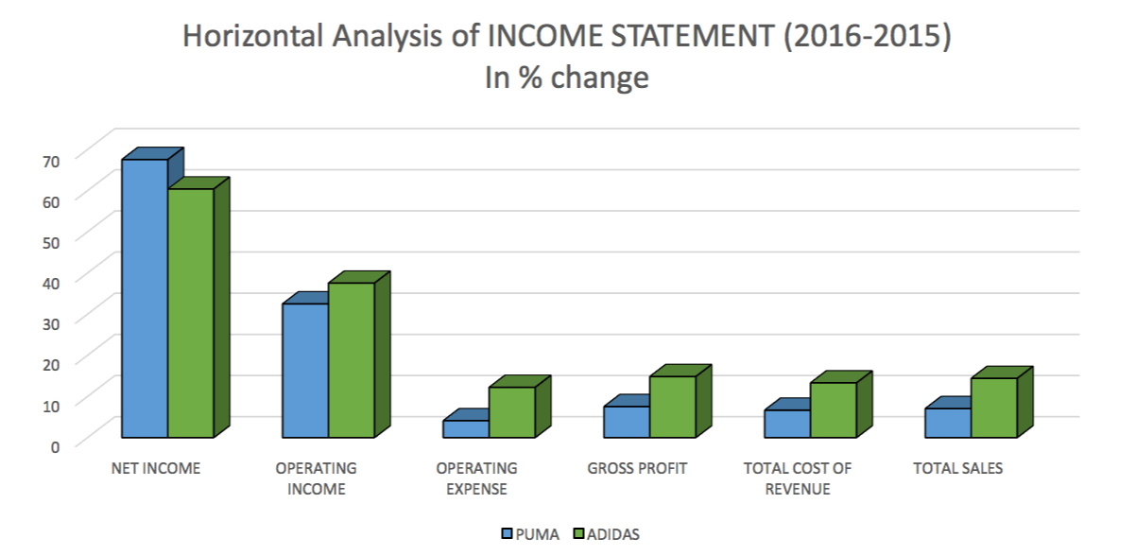
Horizontal Analysis of Income statement
Horizontal analysis has been done for income statement in financial year 2015 and 2016
Operating income of Adidas is higher than Puma.
For the previous period in case of Puma, for net sales change of 7.6% we get a net income change of 67.57%
whereas in case of Adidas net sales change of 14.4% give net income of 49.41%
Gross Profit change for Puma is 7.54 whereas for Adidas it is 14.84

Slide 23
Vertical Analysis
It is a comparative analysis of a financial statement where each line item on accounts is listed as a percentage of another item
One of the main advantages of this analysis is that the balance sheet can be easily compared to any size of organization
Will help understand the relative annual changes within one business.
One of main issues of using vertical analysis for balance sheet is what to use as the benchmark in the percentage calculation
The usual benchmarks are total asset or total liabilities when calculating assets and liability line item percentages
The total of all equity accounts when calculating all equity line item percentages.

Slide 24
Vertical Analysis of Balance sheet
Adidas has incurred a very high percentage of current liability over the total liability compared to Puma as they are heavily investing in business expansion
Adidas has also invested 22% more on marketing than Puma.
Going forward Adidas has a promising working capital position and its ability to meet its near-term obligations from the investments made.
The analysis shows that the Puma’s current assets form 68.3% of its total assets; for Adidas we observe that it has 58.55% higher the proportion of current assets in case to cover all current and non-current liabilities which is total 77.72%.
When it comes to Stockholders equity we see both Adidas and Puma has similar standup.

Slide 25
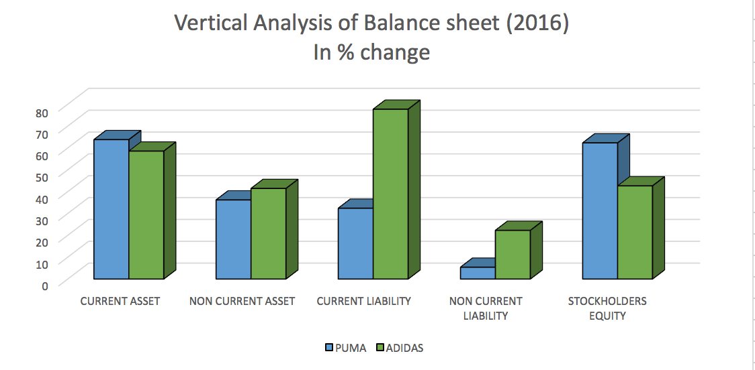
Vertical Analysis of Balance sheet for 2016

Slide 26
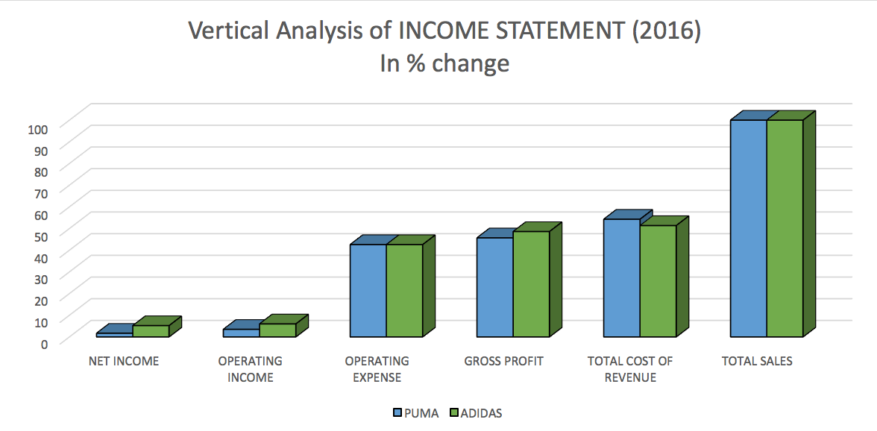
Vertical Analysis of Income statement
On comparative study of Income statement, we see that both the companies have similar standup for all the metrics.

Slide 27
FINANCIAL RATIOS ANALYSIS
Ratio analysis provides key indicators of organizational performance which will help to understand the organization financial results and trends over time
The ratio analysis reveals valuable information about organization’s financial attributes
it helps to compare organization’s ratio with prior periods, competitor or industry average,
Summarizing quite complex accounting details into a relatively small number of key indicators is one of main reasons to calculate ratio
it is important to identify the objective of the finance report before calculating the ratios for generates useful data

Slide 28
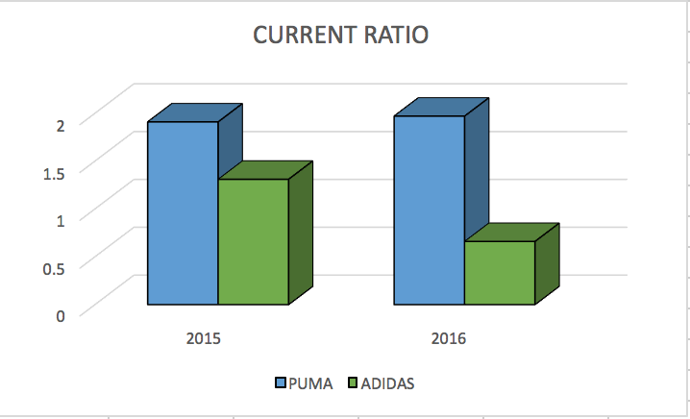
Liquidity ratios: Current ratio
Liquidity ratios measure a company's ability to pay debt obligations and its margin of safety through the calculation of metrics.
Current liabilities are analyzed in relation to liquid assets to evaluate the coverage of short term debts in an emergency.
Puma has ratio over 1.0 for both the years, it has more short-term assets than short-term debts.
But Adidas’ current ratio is less than 1.0 for 2016, it means it could be vulnerable to unexpected bumps in the economy or business climate.

Slide 29
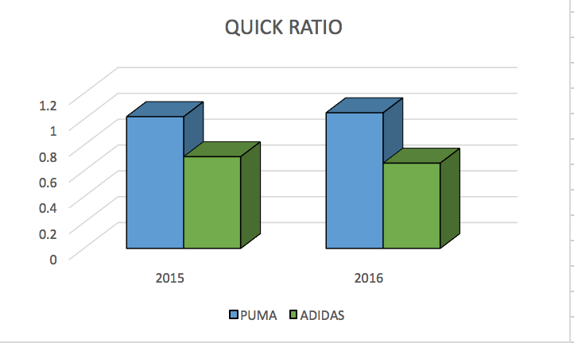
Liquidity ratios: Quick ratio
The Quick ratio a measure of how well a company can meet its short-term financial liabilities.
The quick ratio only considers those assets that could be used to pay short-term debts today.
We notice that Puma has consistently maintained its Quick ratio above while Adidas has ratio less than 1 for both the years that infers it currently can’t payback its current liabilities.

Slide 30
Profitability Ratios
They are financial metrics used to assess a business's ability to generate earnings compared to its expenses and other relevant costs incurred during a specific period of time.
A higher value relative to a competitor's ratio or relative to the same ratio from a previous period indicates that the company is doing well.
The profitability ratios considered for the comparison between Adidas and Puma are:
1 Return on Assets (ROA)
2 Return on Equity (ROE)
3 Gross Margin
4 Earnings per Share

Slide 31
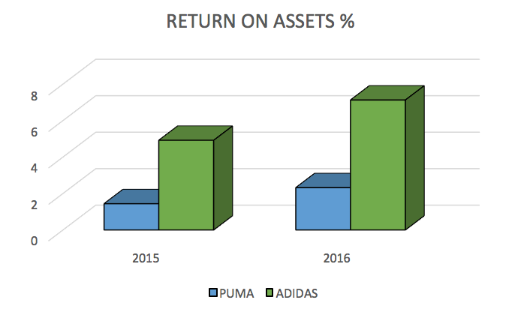
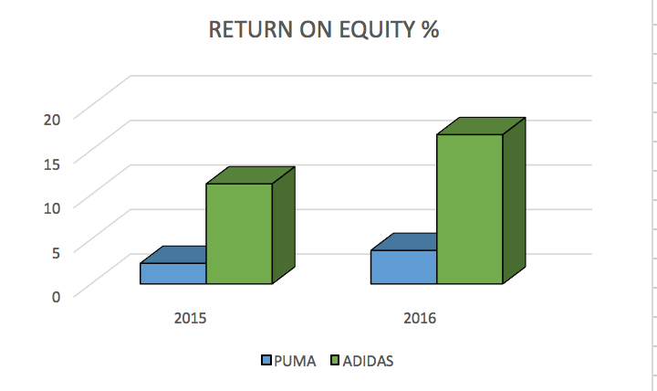
Profitability Ratios: ROA & ROE
Return on Assets (ROA) tells how good the company is at using its assets to make money.
Adidas has a higher ROA for both the years which shows it is more efficient in its asset management in comparison to Puma.
Return on Equity (ROE) tells you how good a company is at rewarding its shareholders for their investments.
Adidas has clearly a better Return on Equity than Puma, it has money from stakeholders to generate profit and grow the company.

Slide 32
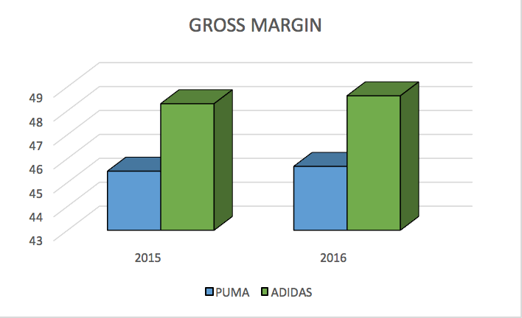
Profitability Ratios: Gross Margin
Gross Margin calculates how much of a company's total sales flow through to the bottom line.
Puma has consistently maintained its Gross Margin for past 2 years at around 45% whereas Adidas has maintained it around 48%.
There is no significant difference between the two companies and both are efficient in retaining money after sales to cover other operating expenses

Slide 33
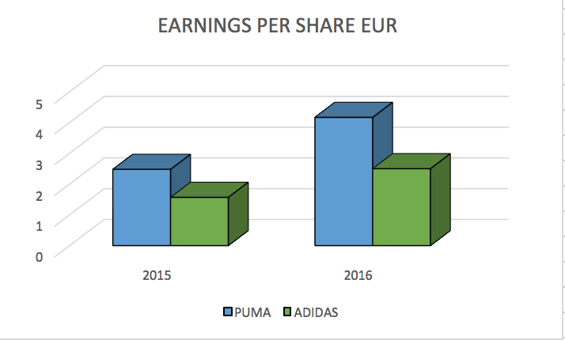
Profitability Ratios: Earnings per Share
The earning per share ratio indicates the amount of company’s profit allocated each outstanding share of common stock
Indicating high amount of earning per share ratio signals potential of generating a significant dividend for investors.
The improvement in the financial result and the lower tax rate contributed to the increase in consolidated net earnings of Puma.
As a result, both earnings per share and diluted earnings per share rose by 68.0 % to € 4.17 in comparison to € 2.48 in the previous year

Slide 34
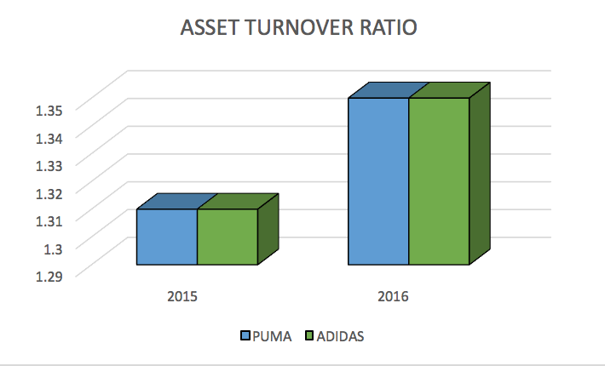
Efficiency Ratios: Asset Turnover Ratio
Gives investors insight into how efficiently a business is employing resources invested in fixed assets and working capital.
Can also be a reflection of how effective a company's management is.
Like Return on Assets, The Asset Turnover Ratio tells you how good the company is at using its assets to make products to sell.
We see no difference between the ratios of both the companies is same and are using their assets competently

Slide 35
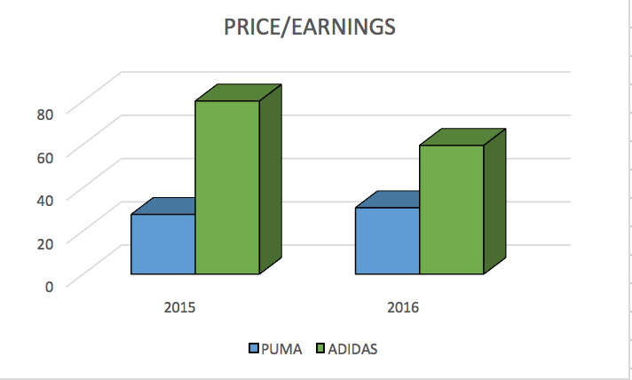
Price Ratio: Price-to-Earnings Ratio (P/E)
Price ratios are used to get an idea of whether a stock’s price is reasonable or not.
Are easy to use and generally pretty intuitive.
Price ratios are "relative" metrics
The price-earnings ratio indicates the dollar amount an investor can expect to invest in a company in order to receive one dollar of that company’s earnings.
Adidas Price per Earning has decreased by 25% since past year but it is still overpriced in comparison to Puma’ stocks.

Slide 36
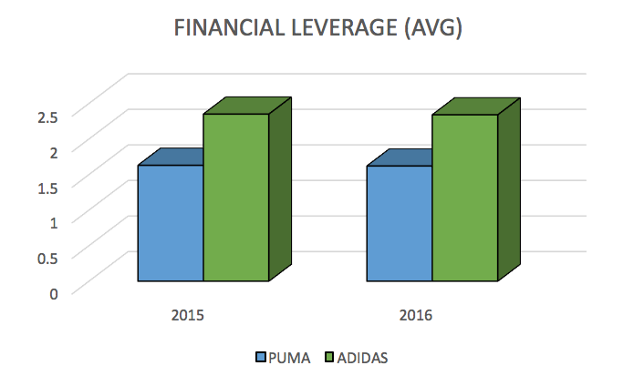
Financial leverage ratios
They measure the overall debt load of a company and compare it with the assets or equity.
looks at how much capital comes in the form of debt (loans) or assesses the ability of a company to meet its financial obligations.
This measurement is important for investors to understand how risky the capital structure of a company and if it is worth investing in.
For both the years, Puma and Adidas have consistent leverage ratio.

Slide 37
CREDITORS DECISION METRICS
Analysis of financial statements gave an insight about the financial standing of Puma and Adidas for 2016.
Using Earnings, revenues, liabilities & Financial health ratios of both the companies we an in depth view of the overall financial standup of both the companies.
From the balance sheet we noticed that assets are increasing for both the firms and there are no significant differences.
but when we analyzed the current liability, Adidas has higher liabilities to pay off.
From a creditors perspective and by analyzing the past years’ financial metrics, it is evident that Puma has been a stable player as compared to Adidas.
Hence, it is more likely to receive the returns from the company and it seems to be less risky from creditors perspective.

Slide 38
INVESTORS DECISION METRICS
Investors are concerned with how their money would be spent in generating profit in sales and how their Return on Investment from the company would increase via share price and dividends.
The overall Profit of the company, Earnings per Share, Gross Margin and Return on Equity suggest that Adidas is more profitable and attractive to potential investors who are looking to increase their capital gains
The stocks of Adidas have been consistently overweight for past three months, recommending us to invest in them whereas Puma’s stock were on hold for two consecutive months before turning overweight for the current month.
The price per earnings ratio of Adidas is 93% greater than Puma for 2016.
Though the Earnings per Share of Puma is higher, but Adidas is also showing significant growth since last year.

